Slide 1





Lecture-2
FUNDAMENTALS - I
•
Programming
Fundamentals in C++
Kartik Mathur

Slide 2


2
Brain Teasers?

Slide 3
BT – 4: Criminal Cupbearers
An evil king has 1000 bottles of wine. A neighboring
queen plots to kill the bad king, and sends a
servant to poison the wine. The king's guards catch
the servant after he has only poisoned one bottle.
The guards don't know which bottle was poisoned,
but they do know that the poison is so potent that
even if it was diluted 1,000,000 times, it would still
be fatal. Furthermore, the effects of the poison
take one month to surface. The king decides he
will get some of his prisoners in his vast dungeons to
drink the wine. Rather than using 1000 prisoners
each assigned to a particular bottle, this king
knows that he needs to murder no more than 10
prisoners to figure out what bottle is poisoned, and
will still be able to drink the rest of the wine in 5
weeks time. How does he pull this off?

Slide 4
3
Warm up!
 Write a pseudo code to print the following
pattern
read N
i<-i+1
1
01
101
0101
10101
while i<=n do
if i%2==0 then
val<-0
else
val<-1
end if
j<-1
while j<=i do
print val
val<-1-val
j<-j+1
end while
print ‘\n’
i<-i+1
end while

Slide 5
Binary Number
System!

Slide 6
6
How is
data
stored?
 Whole Numbers / Positive Integers – Binary
Equivalent. E.g: 23 → 10111
 Characters – Binary Equivalent of their ASCII
Values. E.g: ‘A’ → 65 → 1000001
 Negative Numbers –
2’s complement of
their
counter part
 Floating Values –
Binary Equivalent of 2
integers [ Significant and Exponent].
E.g:
respresented as 123 10^-2. So
1.23 can be
*
we now have two integers 123 and -2.
 Boolean

Slide 7
Time to write our first
program!

Slide 8
8
Program to print “Hello
World”
#include <iostream>
using namespace std;
int main()
{
cout << “Hello world!”;
return 0;
}

Slide 9
Identifiers
 A C++ identifier is a name used to identify a
variable, function, class, module, or any
other user-defined item
 An identifier starts with a letter A to Z or a to
z
or an underscore (_) followed by zero or
more letters, underscores, and digits (0 to 9)

Slide 10
Keywords
 Some reserve words which cannot be
used as identifiers
 These are basically part of the grammar
representing the language
 E.g:
if, while, return, namespace, etc.

Slide 11
Data types
 As we know we need variables to store
information.
 We might want to store information of
various types in a variable like character,
whole numbers, integers, floating point,
boolean etc.
 Based on the data type of a variable, t
e
operating system allocates memory and
interprets the combination of 0s and 1s in
that memory
h

Slide 12
Primitive Data Types
 Boolean - bool
 Character - char
 Integer –
int
 Floating Point float
 Double Floating Point – double
–

Slide 13
Data type modifiers
Several of the basic types can be modified
using one or more of these type modifiers
 signed
 unsigned
 short
 long

Slide 14
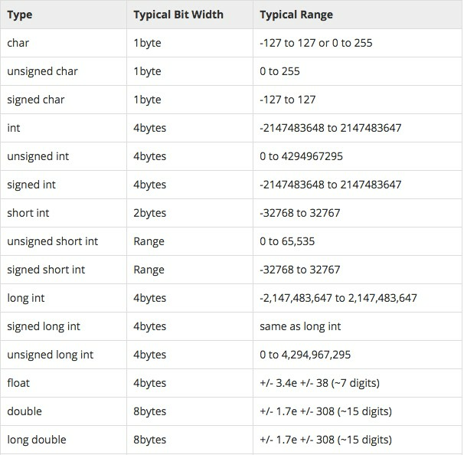
Data types –
size and range!

Slide 15
Variables
 C++ is strongly typed language, so every
variable must be defined before using it.
 type variablelist; // type is the type (eg. int),
varName is the name of the variable
 e.g:
i. int sum;
ii. char ch;
iii. float a, b;
 Variables when just declared have garbage
value until they are assigned a value for the first
time
 We can assign a specific value from the
moment variable is declared, called as
initialization of variable.[float b
= 0.0;]

Slide 16
Statements & Expressions
statement in C++ is the smallest
independent unit in the language
 Statements in C++ are terminated by a
semicolon
 An expression is a mathematical entity that
 A
value
 Expressions are often used inside of
statements.
evaluates to a

Slide 17
Lets look at few statements and
expressions!

Slide 18
18
Basic Operators in a
Expression
 Unary [ +, - ]
 Arithmetic [ +, -, /, *,
% ]
 Brackets [ () ]
 Assignment [ = ]
 Relational [ ==, !=,
>, <, >=, <=]
 Logical Operators [ &&, ||, ! ]
PS - 1:
Relational Operators and Logical
Operators always Evaluate to 0 or 1
PS –
2:
For logical evaluation any non-zero
value is
true.

Slide 19
19
If
Block
 Single If
if (a > 10)
{
cout << “Hello!”;
}
 If Else
If (a>10) {
cout << “Hello!”;
} else {
cout << “World.”;
}
 If .. Else If .. Else
If (a>10 && a <20) {
cout << “Hello!”;
} else if (a >20 && a <30)
{
World!”;
cout << “Hello
} else {
cout << “Welcome to Coding Blocks”;
}

Slide 20
20
While block
while( condition is true )
//do some stuff
{
}

Slide 21
Lets convert some
pseudocodes!
 Read P,R,T and calculate SI
 Find largest of 3 numbers
 Check if a number is prime or not
 Write a program to print the following
pattern
1
2 3
4 5 6
7 8 9 10

Slide 22
22
Recap
 Program Always starts with main()
 { } are used to enclose a block (function,
if, while etc.).
 C++ Compiler Ignores whitespace (s a
p c ,
carriage returns, linefeeds, tabs, vertical
tabs, etc.)
e
 Output
using cout
 Input using
cin
Files
 Header
 Comments (// & /*… */)

Slide 23
Time to try?
 Given a list of N integers, find mean,
maximum and minimum value. You would
be given first N, and then N integers of the
list.
 Print all prime numbers between 2 to N
 Read N and print the below pattern
1
232
34543
4567654
567898765

Slide 24
24
Time for Brain
Teasers!

Slide 25
25
BT –
5: Circular Jail
Cell
There is a circular jail with 100 cells numbered 1-
100. Each cell has an inmate and the door is
locked. One night the jailor gets drunk and starts
running around the jail in circles. In his first round he
opens each door. In his second round he visits
every 2nd door (2,4,6---) and shuts the door. In the
3rd round he visits every 3rd door (3,6,9---) and if
the door is shut he opens it, if it is open he shuts it.
This continues for 100 rounds (i.e. 4,8,12 ---; 5,10,15 -
--; ---; 49,98 etc.) and exhausted the jailor
falls
down.
How many prisoners found their doors open
after 100 rounds?

Slide 26
BT –
6: Greedy Pirates
A pirate ship captures a treasure of 1000
golden coins. The treasure has to be split
among the 5 pirates: 1, 2, 3, 4, and 5 in order
of rank. The pirates have the following
important characteristics: infinitely smart,
bloodthirsty, greedy. Starting with pirate 5 they
can make a proposal how to split up the
treasure. This proposal can either be accepted
or the pirate is thrown overboard. A proposal is
accepted if and only if a majority of the
pirates agrees on it. What proposal should
pirate 5 make?

Slide 27
BT –
7: Infinite Quarter
Sequence
You are wearing a blindfold and thick gloves. An
infinite number of quarters are laid out before you
on a table of infinite area. Someone tells you that
20 of these quarters are tails and the rest are
heads. He says that if you can split the quarters into
2 piles where the number of tails quarters is the
same in both piles, then you win all of the quarters.
You are allowed to move the quarters and to flip
them over, but you can never tell what state a
quarter is currently in (the blindfold prevents you
from seeing, and the gloves prevent you from
feeling which side is heads or tails). How do you
partition the quarters so that you can win them all?

Slide 28
BT –
8: Daughters’ Ages
Local Berkeley professors Dr. X and Dr. Y bump into each
after a
long time.
X
Y
you been?
great! i got married and i have three daughters
now
hey! how have
X
Y
really? how old are they?
well, the product of their ages is 72, and the sum of
their ages is the same as the number on that
building over there
right, ok
know
oh sorry, the oldest one just started to play the
X
Y
...
oh wait ...
hmm,
i
still don't
piano
wonderful!
X
my oldest is the same age!
How old are the
daughters?

Slide 29
29
What is
next class about?

Slide 30
Programming Fundamentals -
1
 Operators/loops
 Continue, r
 Arrays
b e k
a ;

Slide 31
Thank You
!
Kartik Mathur
Kartik.mathur@codingblocks.com
+91-9560196180

